Slide 1
Welcome To Our Project

Slide 2
Introduction
Topic : Ticket Booking System
Group Members :
Alimul Islam ; ID: 181-15-10974
Nasimul Jahan Fahim ; ID: 181-15-10937
Shams Shahriar Bhuiyan ; ID: 181-15-11073
Mohammad Mubassir Kabir; ID: 181-15-10691
Mostakim Billah Emon ; ID:181-15-10923

Slide 3
OBJECTIVES
This Software we can use for :
View Bus List
Book Ticket
Cancel Booking
Bus Status Board
Exit

Slide 4
Description
This is Bus Ticket Booking System. This is a way of online ticket booking which is a smart app where user get information of the bus services & book buses ticket with seats .User can also cancel the booked tickets. There anyone can input their seats how many seats they need. Per Seats price is 200tk .There is also Bus Status Board ,By using it user can check the empty seats and booked seats.

Slide 5
Requirement Specification
Hardware Configuration :
Computer Processor : Pentium4(min)
Hard Disk : 50Gb(min)
Ram : 512Mb(min)more
Software Specification :
Operating System :Windows 7 or above
Language used : “C”

Slide 6
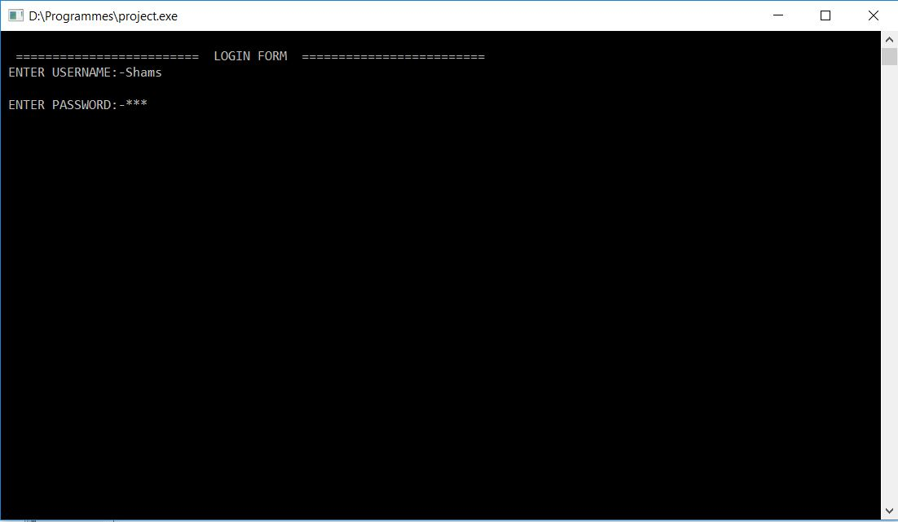
Sample Input & Output :

Slide 7
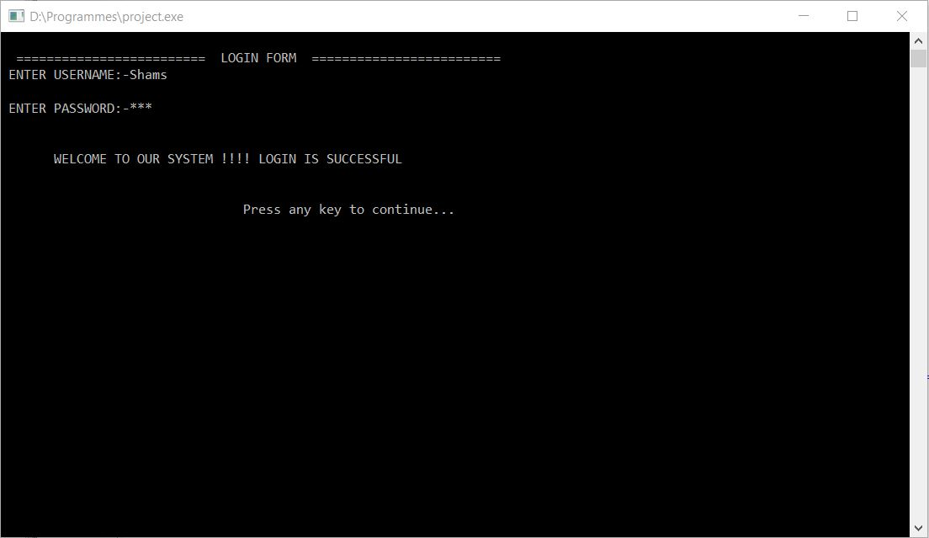

Slide 8
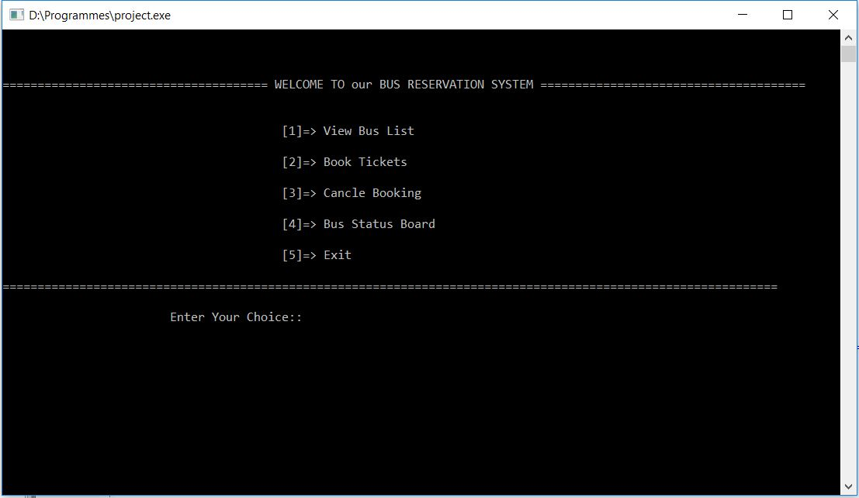

Slide 9
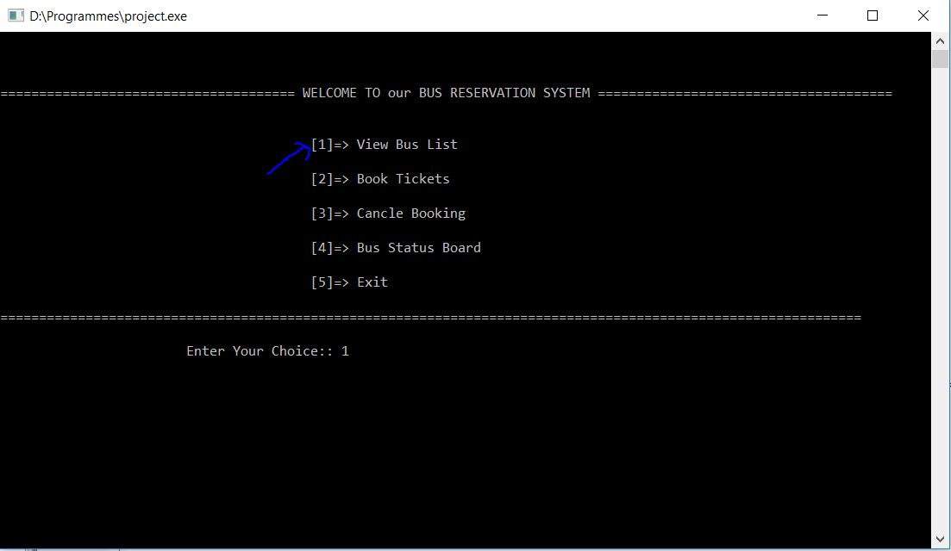

Slide 10
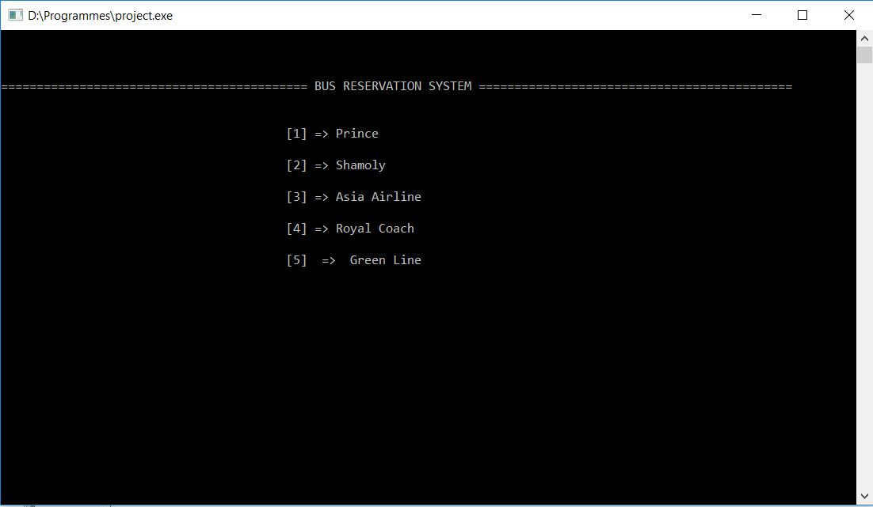

Slide 11
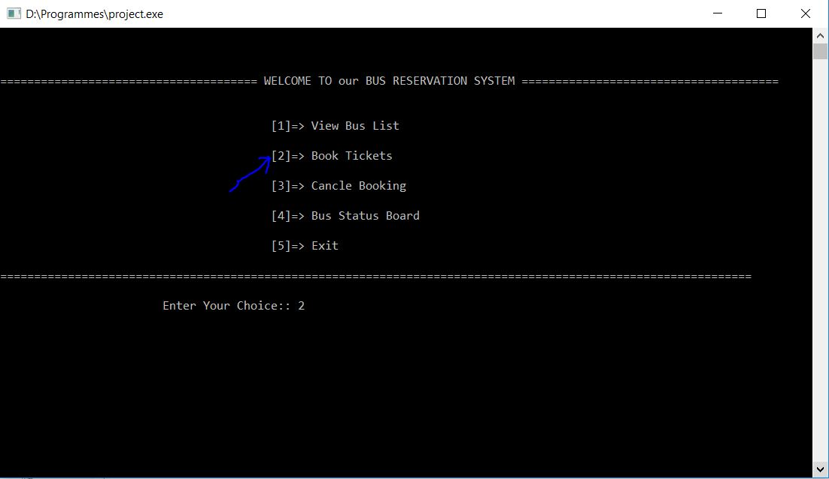

Slide 12
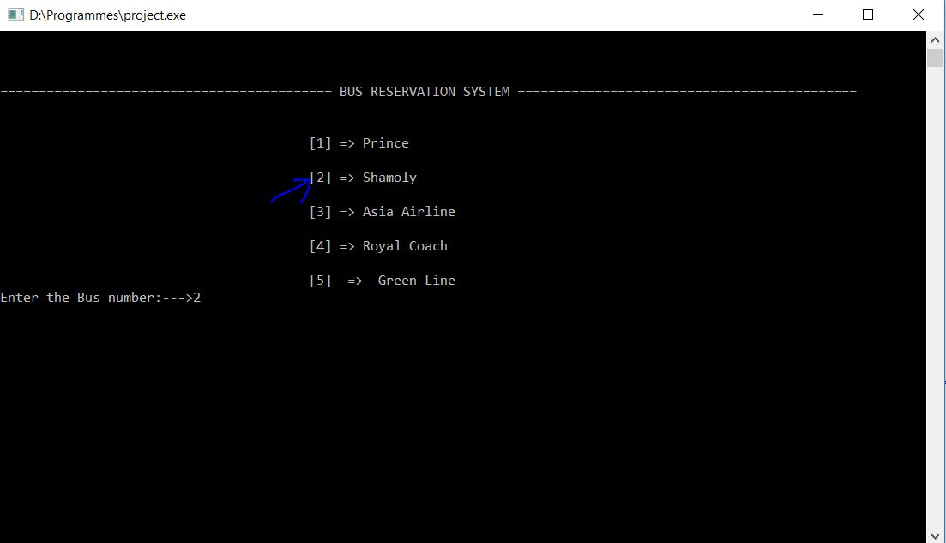

Slide 13
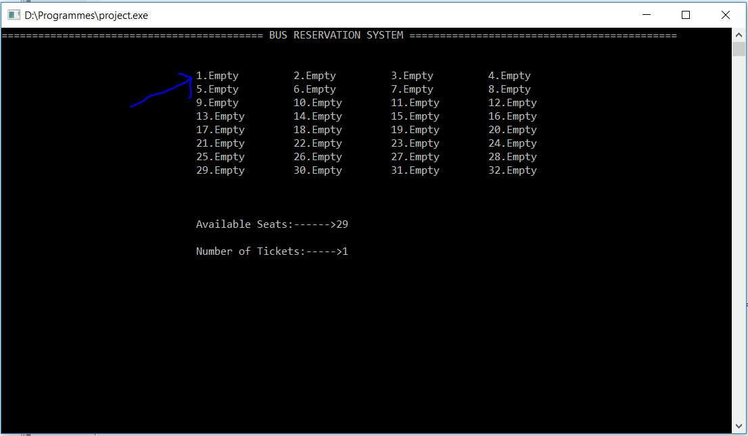

Slide 14
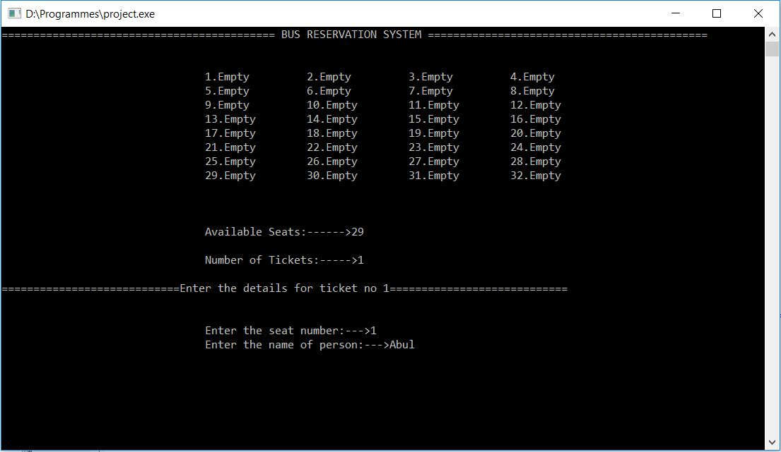

Slide 15
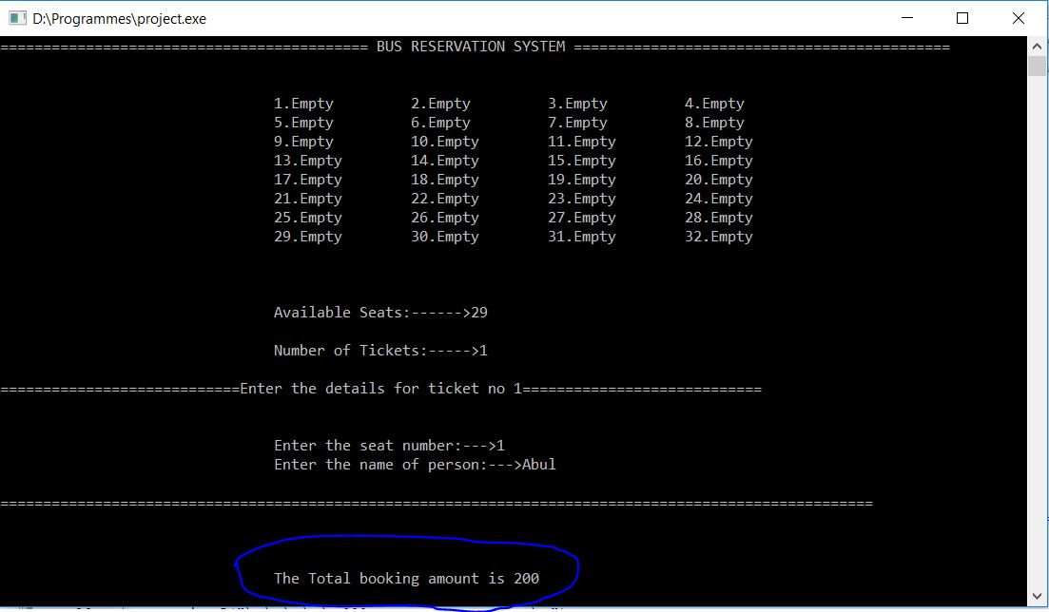

Slide 16
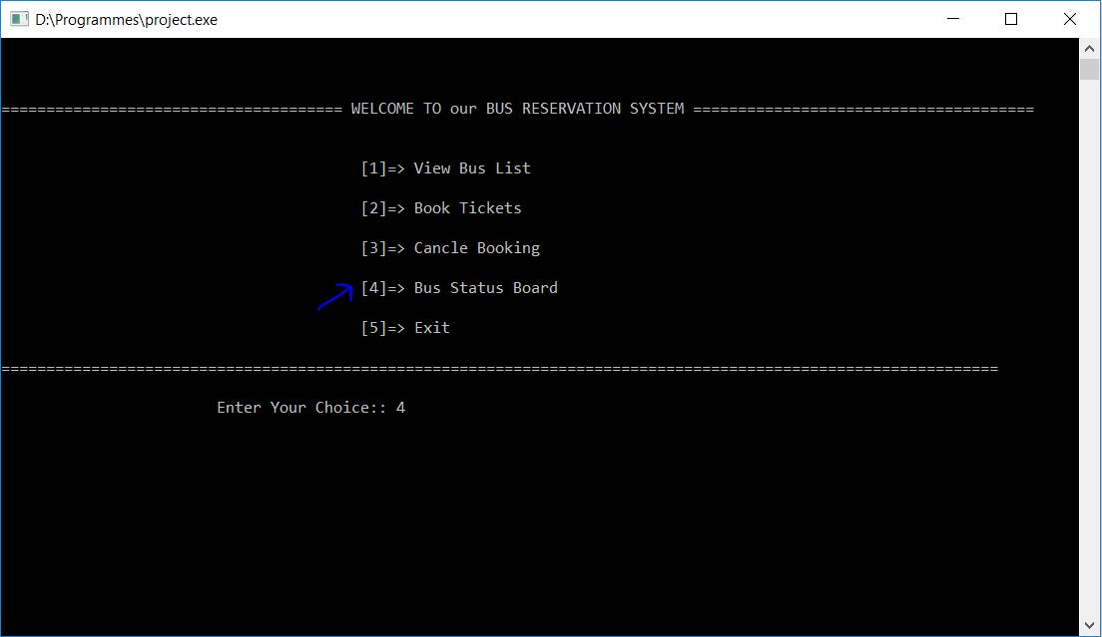

Slide 17
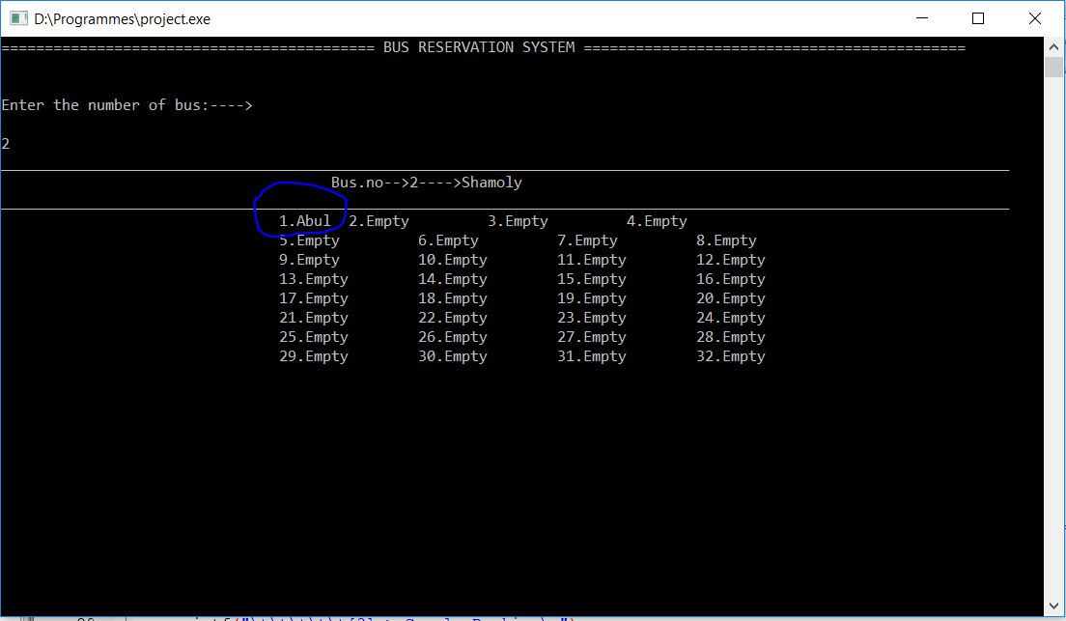

Slide 18
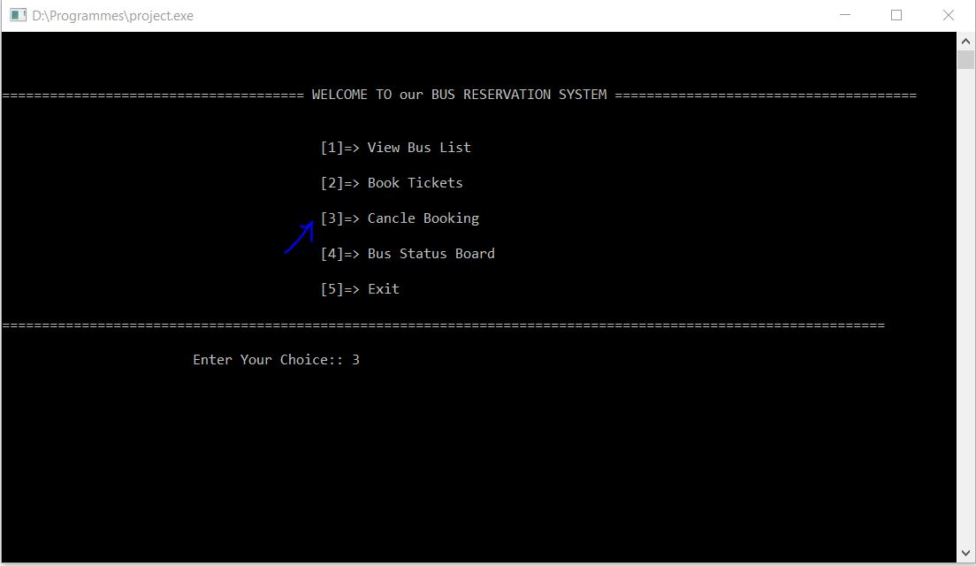

Slide 19
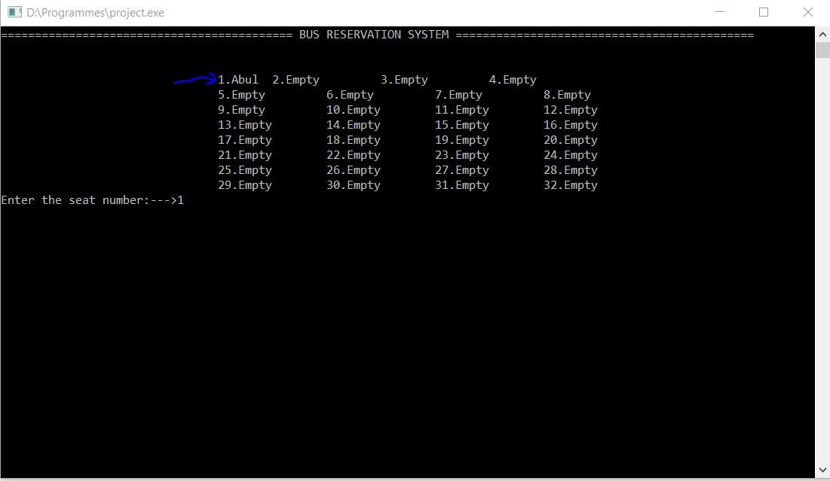

Slide 20
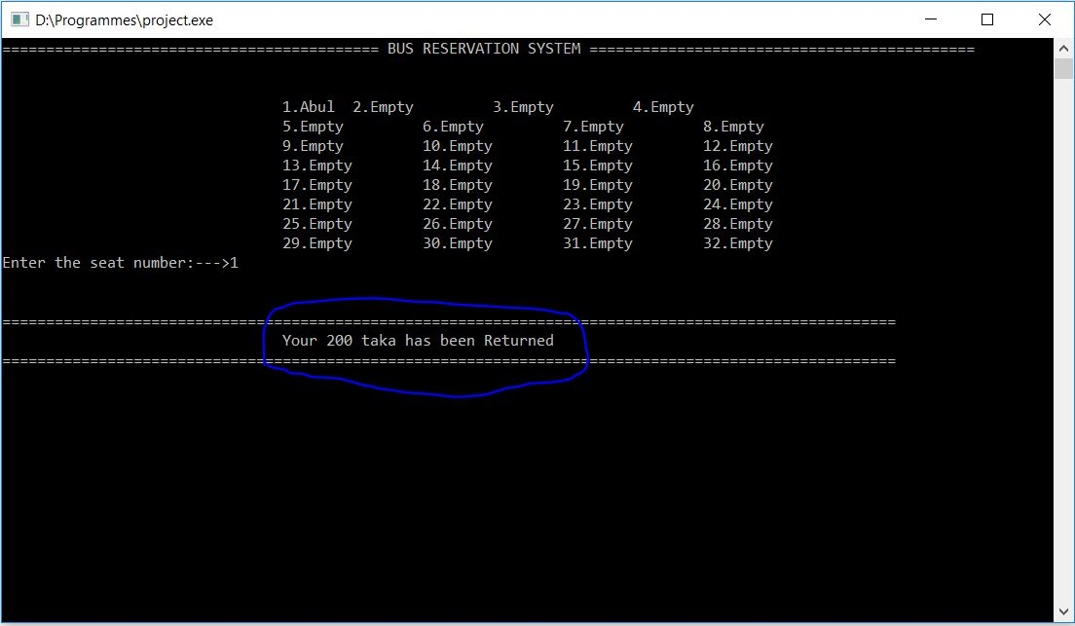

Slide 21
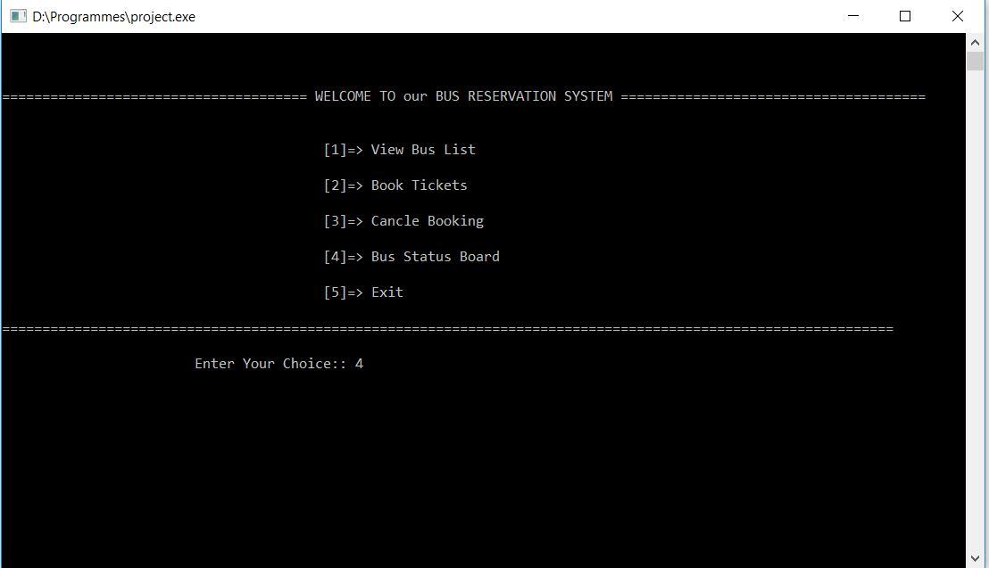

Slide 22
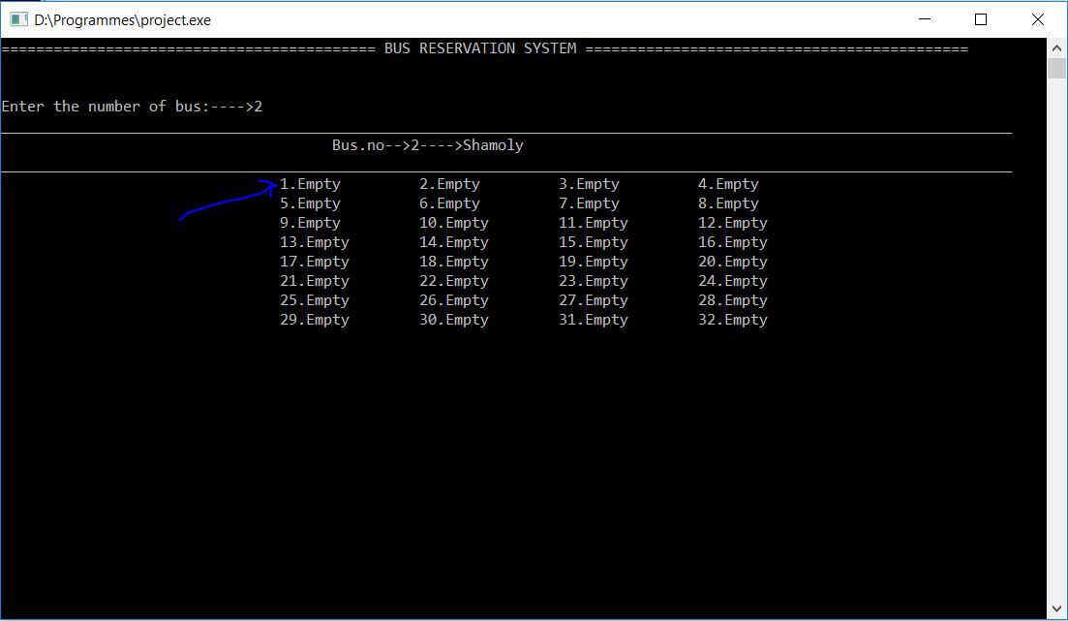

Slide 23
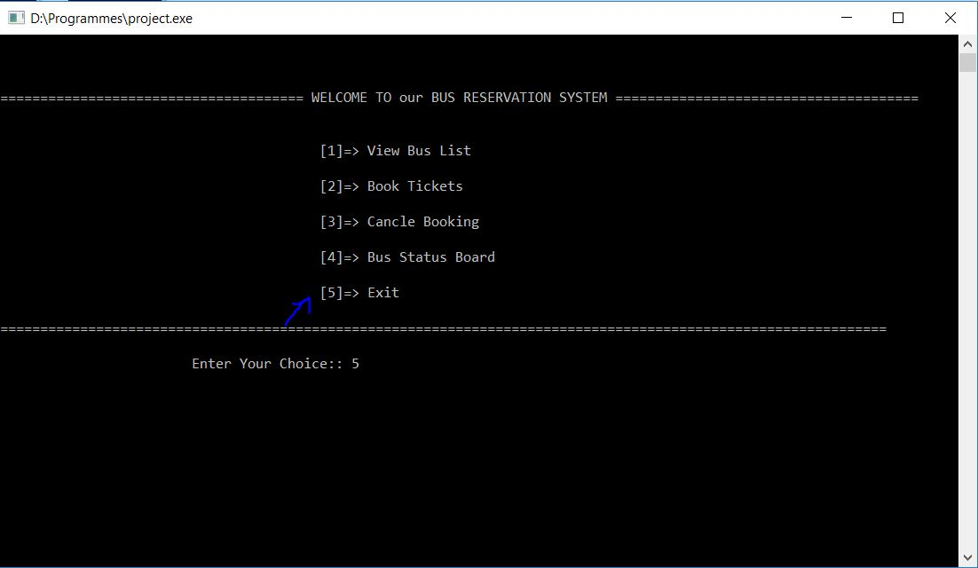

Slide 24
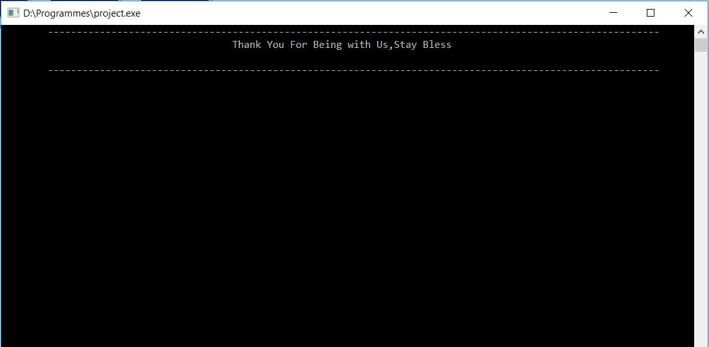

Slide 25
Challenges
1.This can’t be use for local bus
2.This can’t be truck buses
3.In this application we can’t see pick-up points and destination .

Slide 26
Conclusion
1.This system is user friendly
2.This system is available 24 hours and efficient in reservation
3.It has no hidden costs in fares.

